Slide 1
User Command Validation
By:Ishaan Singh

Slide 2
User Command Validation
It is validating the commands entered by user to which root user has provided permissions.

Slide 3
Why we need it?
Not all people have same level of permissions in an organisation.
To provide fatal mistakes.
Managing the directories properly.

Slide 4
Basic implementation example
CASE 1:Adding user using “$useradd <username>”
Follow by updating password “$passwd “
In this case added user in not provided by root user with permissions of creating directory
So, it creates error of permission denied.

Slide 5
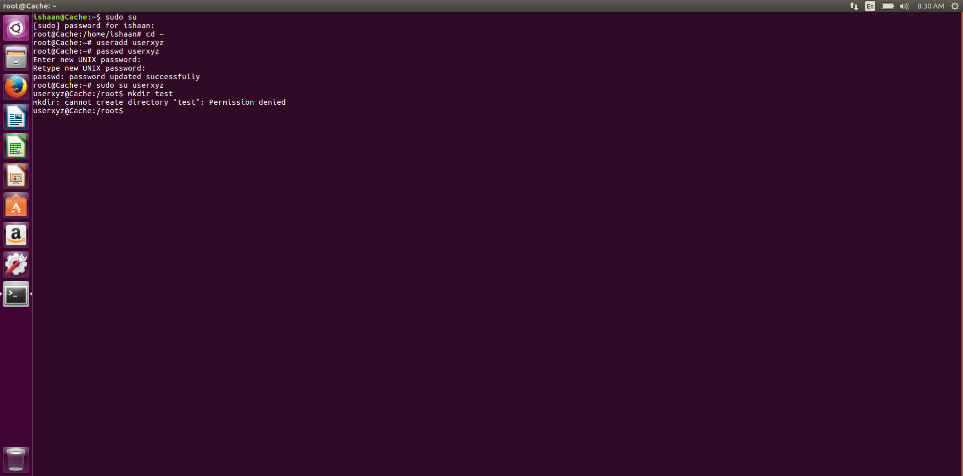

Slide 6
CASE 2:
Adding user using “$adduser <username>”
Then it asks for entering password and some information of new user.
Then enter command “$usermod –aG sudo <username>”
It provides permission to new user to create his own directories.

Slide 7
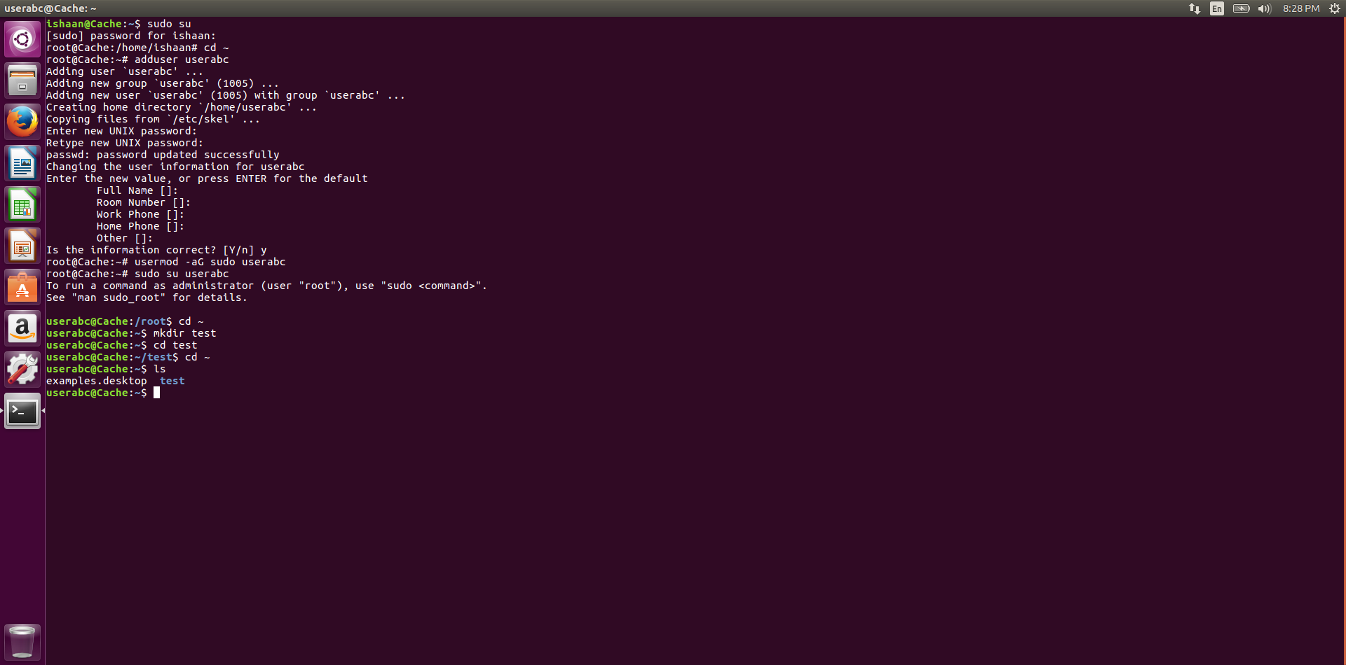

Slide 8
To prevent updation in a directory or file
Use command “sudo chattr +i <directory or file name>
If a user tries to make any update in a directory or file,the error will be displayed.

Slide 9
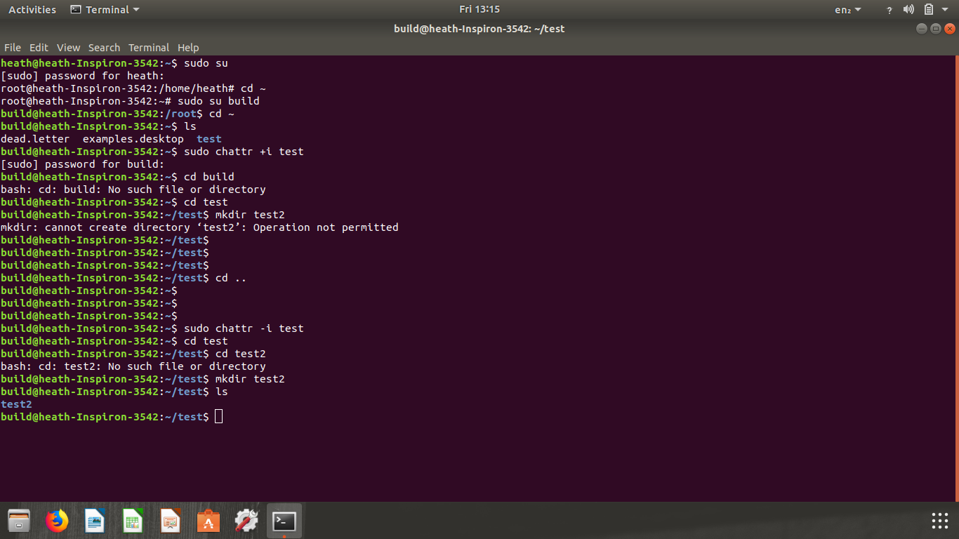

Slide 10
THANK YOU

